Slide 1

University Institute of Liberal Arts and Humanities
Course Name –Communication Skills
Course Code – 23PCH-105
Office order
DISCOVER . LEARN . EMPOWER

Slide 2
COURSE OBJECTIVES
The Course aims to:
1 | Augment students overall communication and interpersonal skills by making them realize the importance of good oral and written English Language in professional life.
2 | Enrich their reading capability with special emphasis on expanding vocabulary and grammatical formations.
3 | Build exceptional speaking, reading and writing skills by correcting grammatical errors and pronunciation through practice.
4 | Enhances soft skills by fostering self awareness, confidence and a positive attitude in students’ ability to communicate effectively in English.

Slide 3

Course Outcomes
On completion, the students are expected to:
CO Number | Title | Level
CO1 | Apply appropriate Listening, Speaking, Reading and Writing Skills (LSRW Skills) with correct non-verbal cues to attain expertise in soft skills. | Apply
CO2 | Apply correct contextual and comprehensible written text in the form of paragraph writing, short compositions business correspondence, using logical support and argument in a wide range of communication situations. | Apply
CO3 | Demonstrate linguistic competence while speaking and during presentations through accuracy in grammatical usage, vocabulary, pronunciation and intonation. | Apply
CO4 | Evaluate information as critical readers, speakers and writers applying ethics in communication and being sensitive in cross cultural communication. | Evaluate
CO5 | Create original, digital content for websites, blogs, vlogs and personal social media profiles etc. | Create
www.blogspot.com

Slide 4

Office Order
Office order is a means of internal communication within an organization.
The term 'order' generally means telling subordinates to do or refrain from doing a specific job.
By passing an order, high level executives want their subordinates to carry out the order.
http://matrixdubai.com/

Slide 5
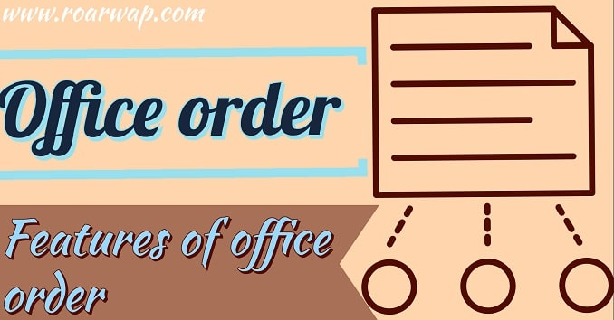
Features of Office Order
It is a means of Downward Communication.
It carries a stamp of authority.
People working at lower level are bound to accept this.
www.roarwap.com

Slide 6
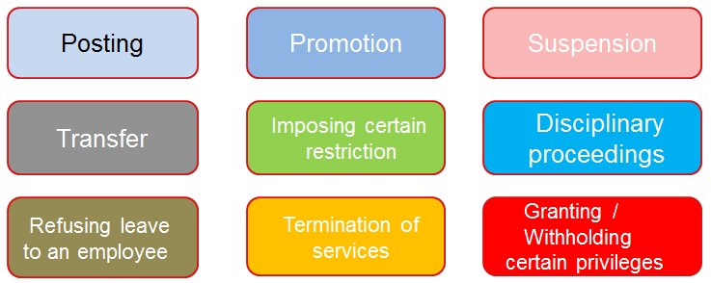
Matters Concerned
It is used to communicate matters concerning:

Slide 7
Essentials of Office Order
The order must be precise.
It should be written in very simple words.
The order should be written in unoffending language
It should clearly specify for whom they are meant.
It should be correct, short & to the point.
It must contain specific instructions or directions for compliance.
It must be authentic & duly signed by a competent authority.

Slide 8
Poll Question 1
‘Transfer’ is one of the matters that is communicated through office orders.
Yes
No

Slide 9
SAMPLE
Aman Watch Company
New Delhi
OFFICE ORDER
Reference :HR/2016/08 Dated: 15-07-2020
The management is pleased to grant the promotion to Mr.Ashish Sinha in recognition of his meritorious services to our organization for the last five years. With effect from 20-07-2020, he will hold the rank of Sales Manager and would be entitled to all the emoluments and benefits of this post.
Copy to: Amit Sood
Accounts Officer Human Resource Manager

Slide 10
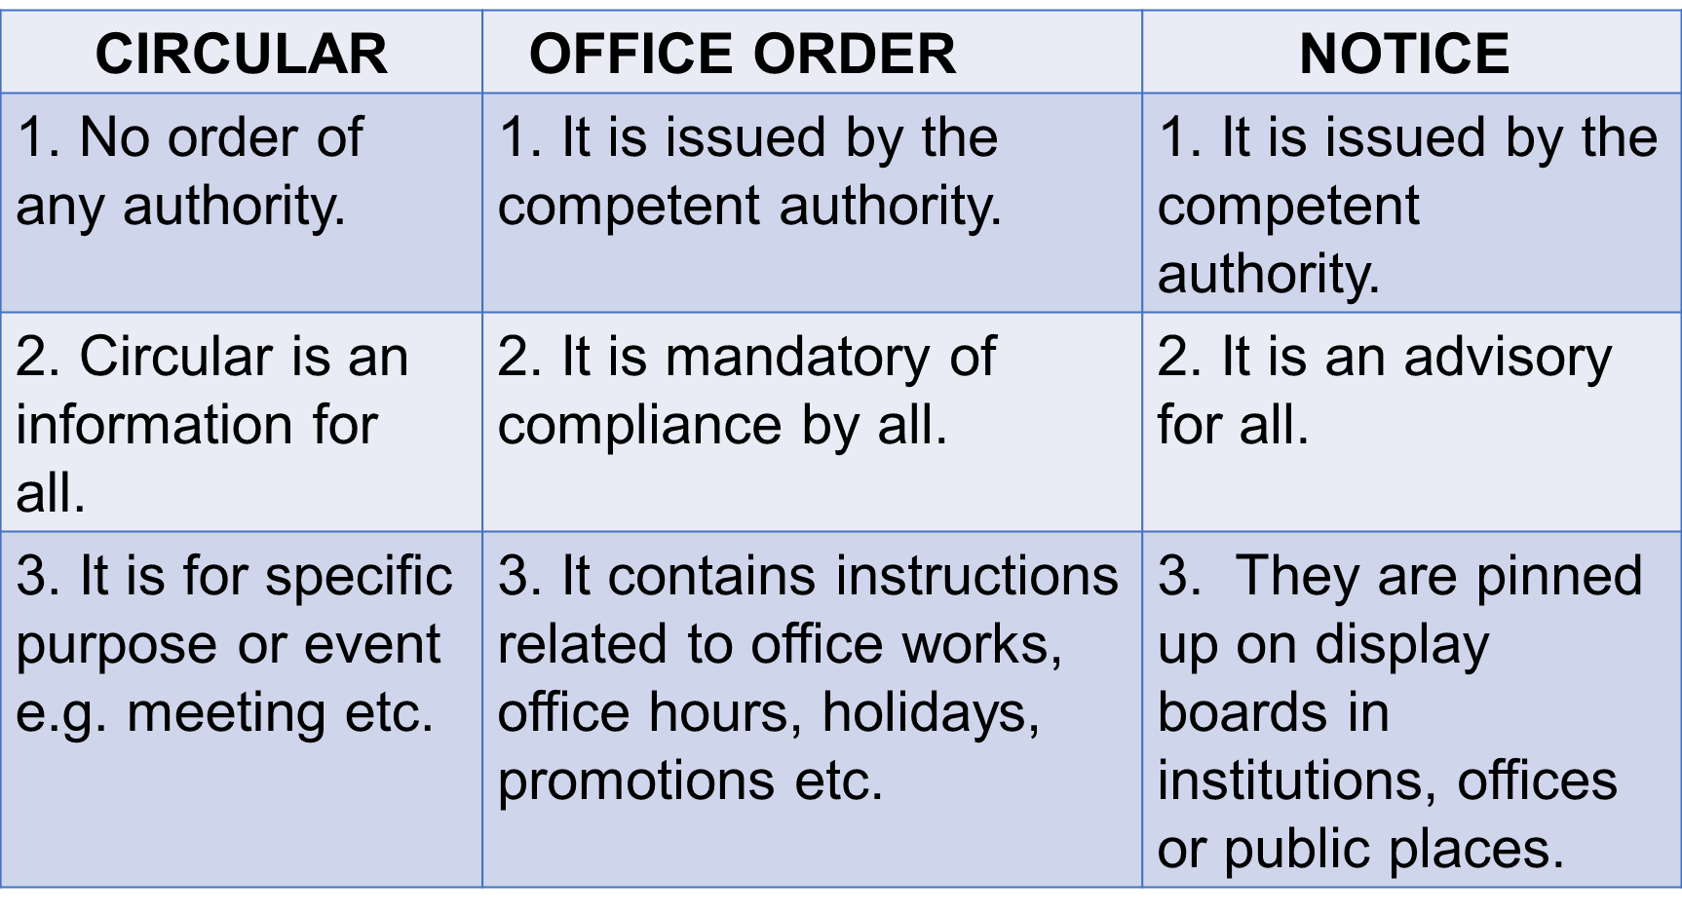
DIFFERENCE

Slide 11
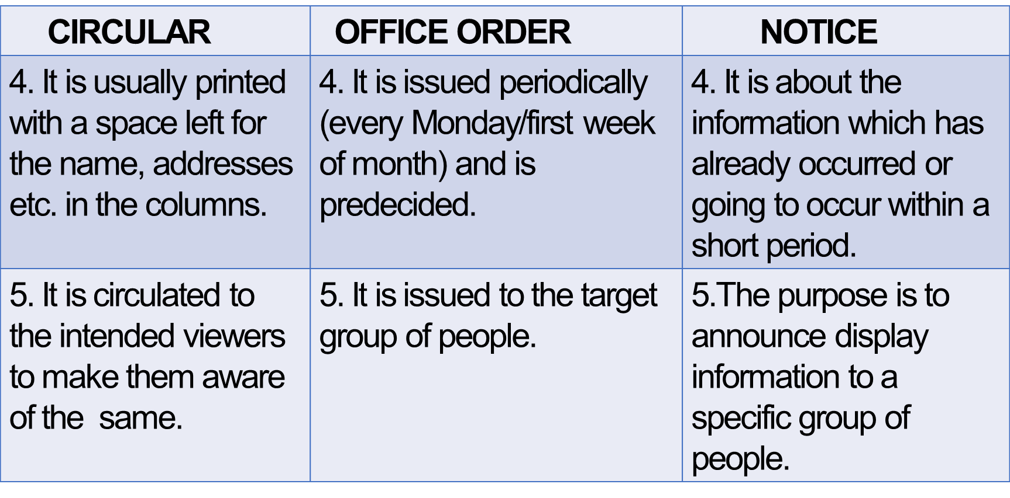
Differences contd.

Slide 12
Poll Question 2
Tick the correct option that better suits to Office Order:
is mandatory of compliance by all.
is an information for all.
is an advisory for all.

Slide 13
Applications
The instructions about the work related information by the organization helps to work smoothly.
Correct grammar , punctuation and spellings are the keys in written communication , hence these can be improved with the practice.
Technical words used in writing skills improve vocabulary .

Slide 14
Assessment Pattern
Students are assessed on the basis of the following parameters:
Hourly Tests - 2
Assignments
Surprise Test
Quiz
Student Engagement
End Semester Exam

Slide 15
References
https://www.pearson.com/us/
https://www.atpeducation.com/home
https://www.learnpick.in/prime/documents/notes/details/4727/memos-circulars-and-notice
Practical English Usage fourth edition by Michael Swan(Online book at Flipkart).

